Slide 1


Slide 2
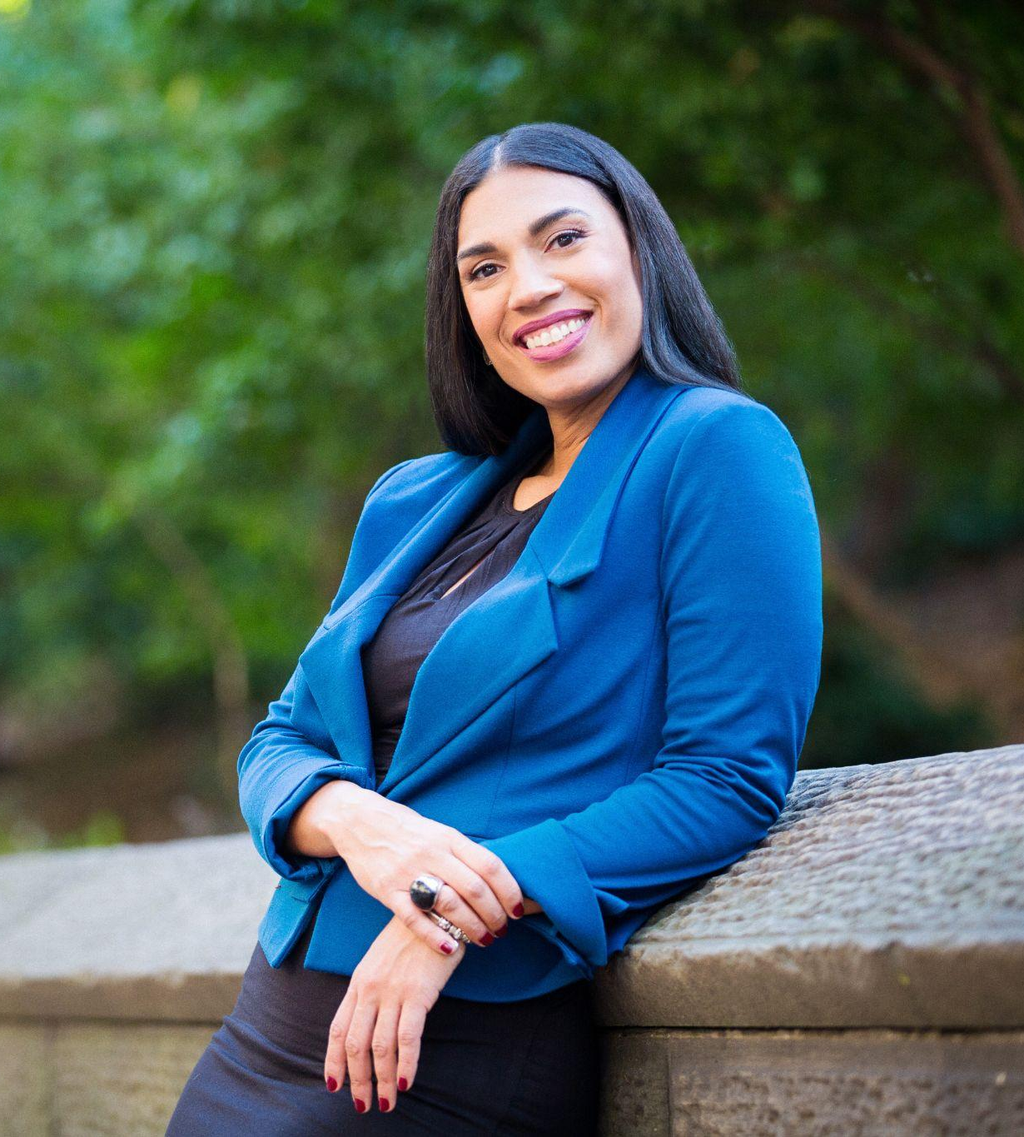

A B O U T
WENDY PERDOMO
Wendy Perdomo is the Founder and Executive Leadership & Life Coach at Coaching Women of Color, LLC, a premier leadership development firm dedicated to advancing the confidence, voice, and visibility of professional women of color in the workplace. With a mission to empower women to thrive in their current roles and rise into senior, executive, and C-suite leadership, Wendy brings a unique blend of strategic coaching, facilitation mastery, and deep cultural competence to every engagement.
A motivational and international speaker, Wendy is passionate about igniting transformational growth, fostering resilience, and equipping leaders with the tools to lead authentically and unapologetically.
With over two decades of experience in the nonprofit education sector, she is a certified executive coach and expert facilitator who has designed and led leadership programs that have supported thousands of middle, senior, and executive-level leaders across industries.
Her coaching and workshops address a wide range of leadership topics, including imposter syndrome, executive presence, team development, navigating bias and microaggressions, salary negotiations, work-life integration, and courageous communication.
Wendy holds a B.A. from Colgate University and dual master’s degrees (M.P.A. and M.S.Ed.) from Baruch College’s School of Public Affairs.
100+
500+
30
70+

Slide 3


A B O U T
COACHING WOMEN OF COLOR
Founded in 2017 by Wendy Perdomo, Coaching Women of Color, LLC., is dedicated to empowering professional women of color to overcome unique challenges and achieve their personal and professional goals.
Our mission is to support women of color and professionals in reclaiming their power, overcoming limiting beliefs, and taking bold action towards designing the life and career they desire.
We envision a future where women of color are fully represented in leadership positions across all industries, living lives by design, not by default, and serving as catalysts for positive change in their communities.
UNIQUE VALUE PROPOSITION
Empower women of color to navigate and excel in complex environments.
Partner with organizations to create environments that foster psychological safety and embrace diverse strengths and belonging..
Strengthen communication and team dynamics to improve collaboration and organizational outcomes.
Provide actionable strategies that lead to measurable career advancement and organizational impact.
Foster lasting change by embedding fairness, opportunity, and effective collaboration into the culture of leadership and team development.

Slide 4


W H Y P A R T N E R W I T H
COACHING WOMEN OF COLOR
We bring a unique and impactful approach to leadership development for individuals and organizations. Here’s why organizations and individuals choose to partner with Coaching Women of Color:
TAILORED SOLUTIONS FOR WOMEN OF COLOR
We provide coaching programs that address the distinct challenges women of color face in professional environments, fostering personal and organizational success.
COLLABORATIVE PARTNERSHIPS WITH ORGANIZATIONS
We work closely with corporate, nonprofit, and educational organizations to design and deliver customized leadership development programs.
TAILORED SOLUTIONS FOR WOMEN OF COLOR
PROVEN RESULTS ACROSS SECTORS
With experience supporting leaders in diverse settings, we understand the dynamics of various industries and tailor our approach to deliver measurable outcomes.
CULTURALLY COMPETENT SUPPORT
Our team is equipped with the expertise to provide executive coaching, ensuring our work resonates with individuals and aligns with organizational values.
EMPOWERING LEADERSHIP AND TEAMS
We guide leaders in shaping work environments that prioritize belonging, open dialogue, and professional growth for all.

Slide 5

SPEAKER
Navigating Workplace Bias and Microaggressions
Personal Branding and Career Visibility
Career Transition and Pivoting
Salary Negotiation and Career Advancement
Finding and Using your Voice in the Workplace
Leadership Development and Executive Presence
Effective Networking and Building Strategic Relationships
Overcoming Imposter Syndrome and Building Your Self Confidence
Creating a Professional Development Plan
Building and Leading High-Performing Teams
Self- Advocacy in the Workplace
Creating a Psychologically Safe Culture for Your Team

Slide 6




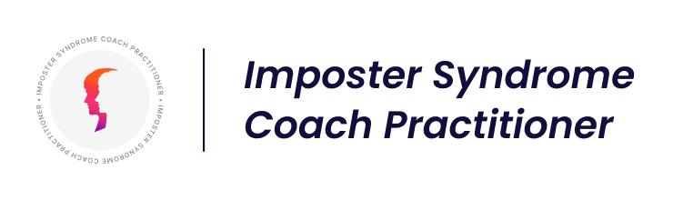

HIGHLIGHTS OF MY VAST EXPERIENCE
C E R T I F I C A T I O N S
Conscious Leadership for Equity
International Coaching Federation Member Badge
Trauma Informed Advocate Certification
C O N S U L T I N G
Women of Color in Pharmaceutical (WOCIP)
Lead Facilitator Global Accelerator Program
Surge Institute
Executive Coach & Instructor
Urban Resource Institute
Keynote Speaker & Executive Coaching
University of Michigan
Executive Coach for Group Coaching Program
Developing Capacity Coaching, LLC,
Coach Affiliate
NJ Arts and Cultural Renewal Fund
Strategist and Lead Facilitator
International Coaching Leadership Institute Rising
Instructor

Slide 7





























TRANSFORMING LEADERS FROM

Slide 8
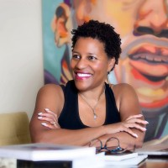
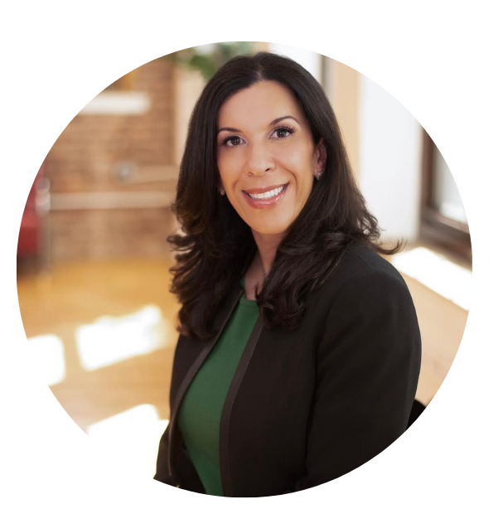
Client
TESTIMONIAL
LYNNE TOYE
New Jersey
Wendy facilitated a board retreat for us. She is a brilliant facilitator whose empathetic approach builds trust quickly. Wendy’s superpower is the speed with which she is able to assess needs, navigate dynamics, and coalesce groups around shared goals. We were extremely pleased with the quality and clarity of Wendy’s preparation, delivery, and follow up. She is in a class by herself! I would recommend her without hesitation.
Executive Director, NJ Arts & Cultural Renewal Fund
It has been both an honor and privilege to work with Wendy. I have left all our interactions inspired and excited for what is yet to come. Wendy is a thoughtful leader who truly cares about supporting and developing her team, her colleagues, her clients and any organization that she serves, She is a high impact leader who authentically mentors and coaches. I can not recommend her enough!
TANYA RAMOS-PUIG
Jacksonville, Florida
CEO, Monique Burr Foundation for Children

Slide 9
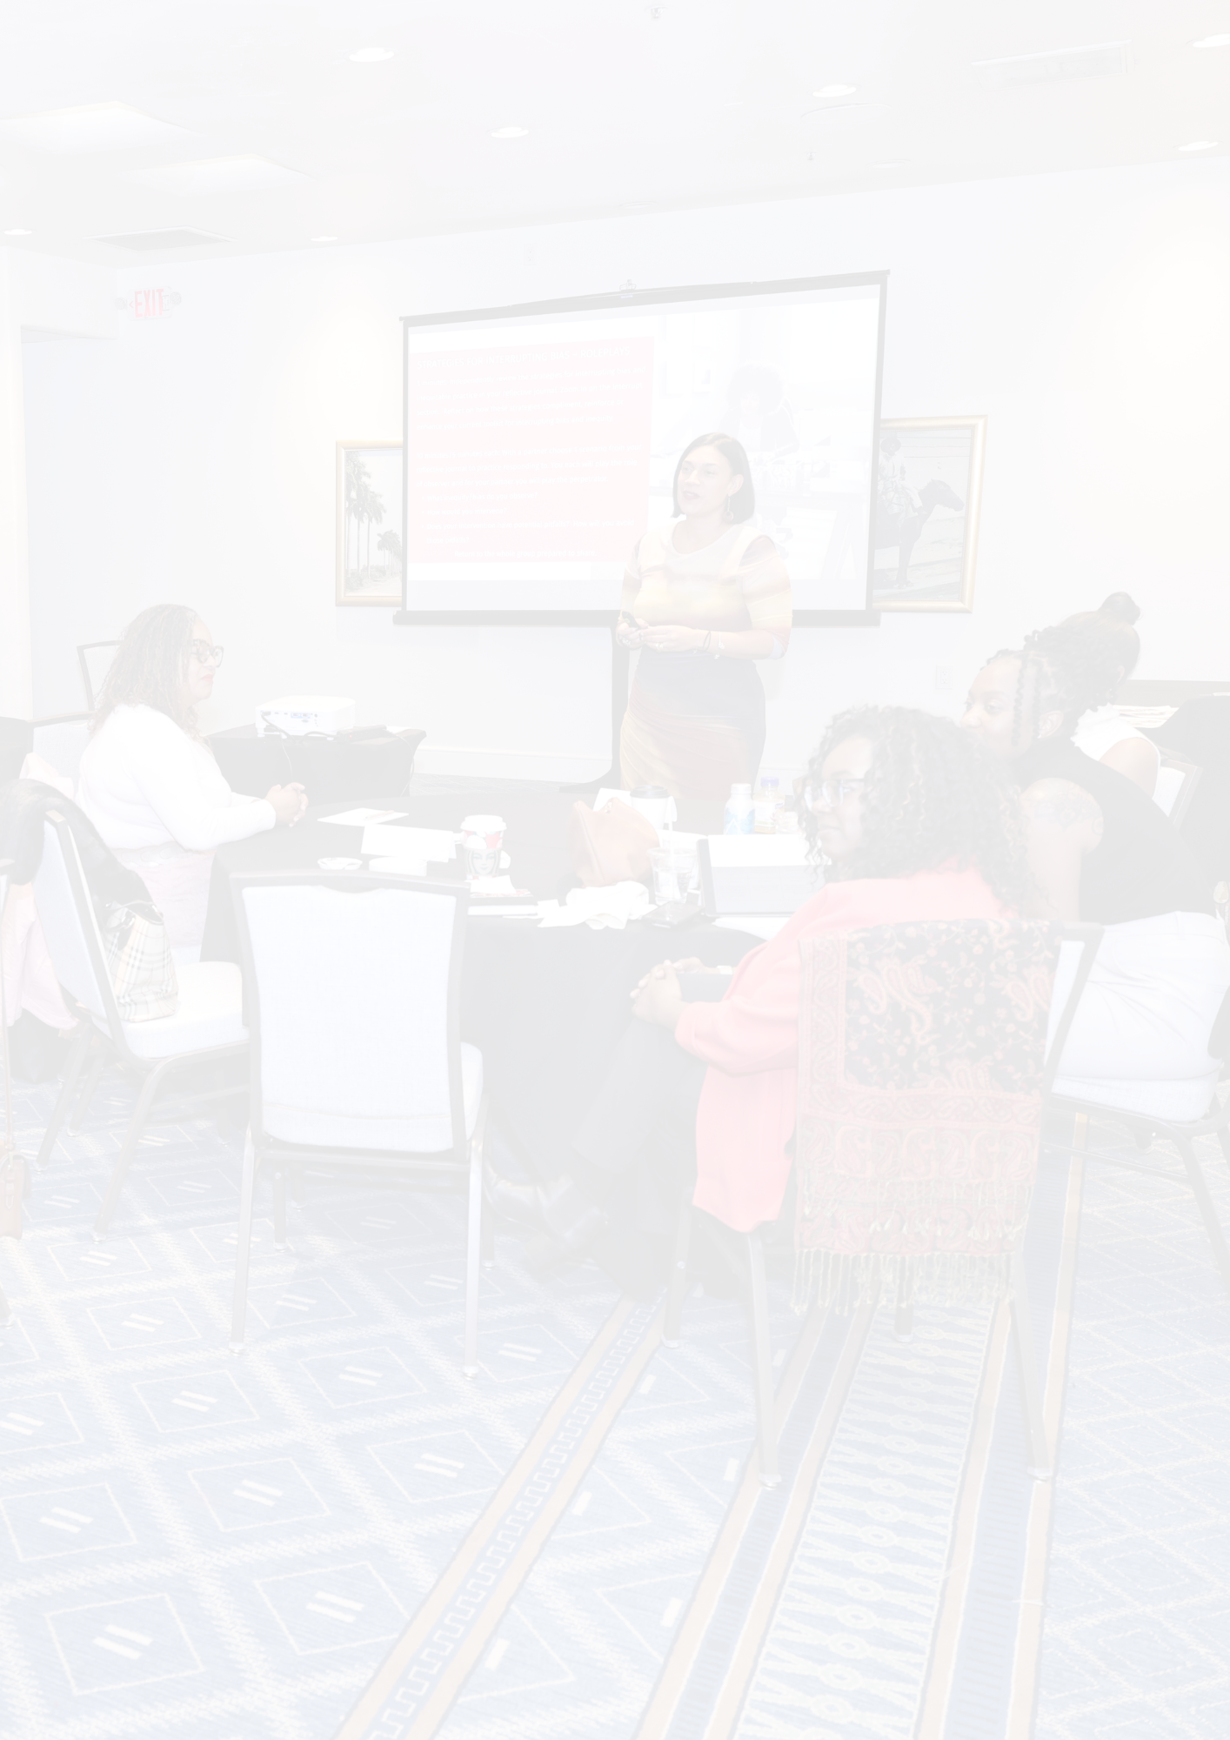
Audience
IMPACT
The speaker Ms. Perdomo was awesome.
I enjoyed Wendy's talk—great guidance and encouragement to us as leaders.
You had an incredible message to share and I’m so glad to have had the privilege to hear you today. Thank you for your time and for your inspiration.
Great job Wendy…loved your presentation and passion. I'm already receiving messages from the participants…that they loved it! Thank you
Wendy was invigorating. I enjoyed the guest speaker. She was great!
Wendy touched on a lot of things that can be shared and implemented.
Wendy is a breath of fresh air and a masterful storyteller— and someone who speaks with warmth, authenticity, and clarity. I’m truly grateful that God, life, and the universe aligned to connect me with Wendy.

Slide 10
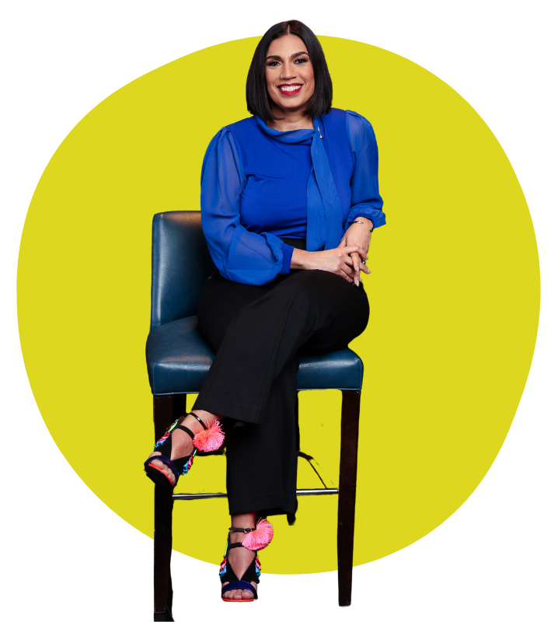
SERVICES OFFERED
As an Executive Leadership and Life Coach, I offer transformative experiences designed to inspire, educate, and drive meaningful change.
My services provide actionable strategies, deep insights, and an engaging approach that fosters leadership growth, personal development, and organizational success.
KEYNOTE PRESENTATIONS - Thought-provoking conversations that inspire and challenge audiences to embrace their leadership potential, overcome barriers, and cultivate confidence in their personal and professional lives.
WORKSHOPS AND TRAININGS - Interactive sessions tailored to equip professionals with leadership skills, emotional intelligence, executive presence, and personal development strategies to thrive in their careers and organizations.
PANELS AND MODERATED DISCUSSIONS - Engaging and insightful panel contributions or expert moderation of discussions on leadership, workplace equity, career growth, and personal empowerment for women of color and diverse professionals.
CUSTOMIZED PROGRAMS - Coaching and development programs designed to meet the unique needs of individuals, teams, or organizations, focusing on leadership advancement, diversity and inclusion, and career strategy.
GROUP COACHING - A supportive and empowering coaching experience for women of color professionals, designed to foster leadership confidence, career acceleration, and personal breakthroughs in a shared, community-driven environment.
LEADERSHIP RETREATS - Transformational in-person or virtual retreats designed to help leaders recharge, reflect, and build the skills necessary to lead with authenticity, resilience, and purpose.

Slide 11




LET’S WORK TOGETHER
Let’s work together to create lasting change. Whether it's a keynote, panel discussion, workshop, or corporate event, I bring actionable insights, powerful storytelling, and a passion for driving meaningful change for individuals and organizations.
wendy@coachingwomenofcolor.com
coachingwomenofcolor.com
linkedin.com/in/wendyperdomoleadershipcoach/
@coachwendyp

